Slide 1
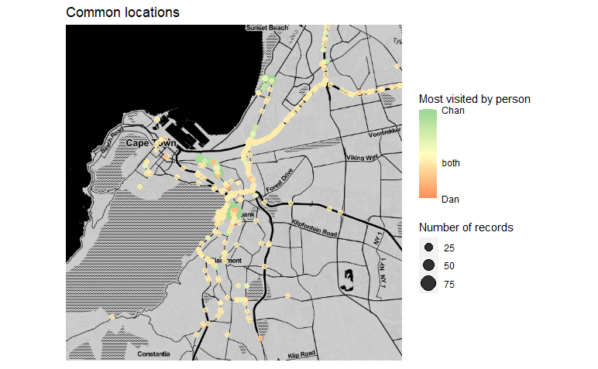
My apartment
My office
The university

